Slide 1
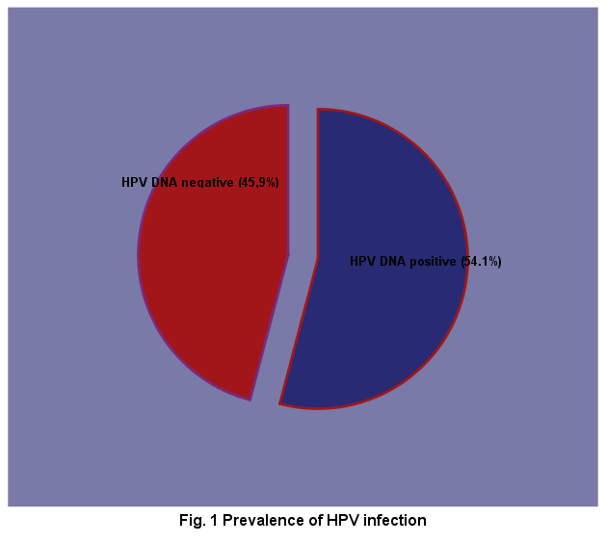
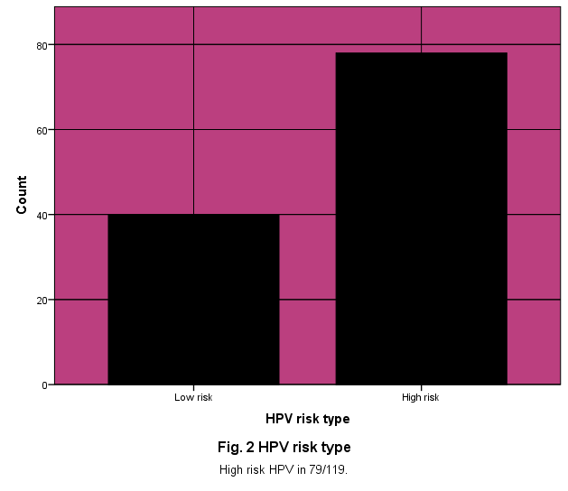
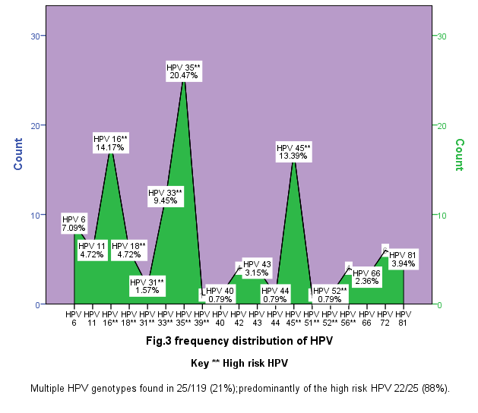
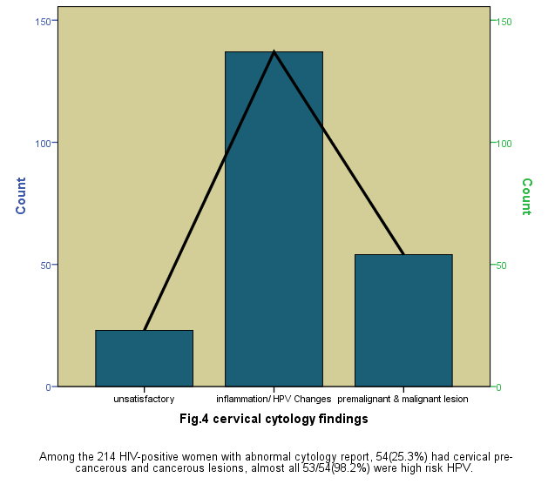
Burden of Human Papillomavirus infection among HIV positive women in North Central Nigeria: A cross sectional study
M.M. Yakub¹, C.G. Anaedobe², A. Fowotade³, M.M. Manga⁴, R.A. Bakare³, B.A. Abimiku⁵
¹ Federal Medical Center, Dept of Medical Microbiology & Parasitology, Keffi, Nasarawa Nigeria, ² University of Abuja Teaching Hospital, Dept of Medical Microbiology & Parasitology, Gwagwalada, Abuja, ³ University College Hospital, Dept of Medical Microbiology & Parasitology, Ibadan. ⁴ Federal Teaching Hospital, Dept of Medical Microbiology & Parasitology Gombe, ⁵ University of Abuja Teaching Hospital, Dept of Histopathology, Gwagwalada, Abuja.
Introduction
Discussion
Cervical cancer is the second most prevalent cancer among women in Nigeria.¹
High risk human papillomavirus (HPV) genotypes is the major cause of cervical cancer.²
Persistent high risk HPV infection is higher among women living with HIV/AIDS.^{2,3}
Women living with HIV are under-represented in the global estimate of HPV infection.⁴
High prevalence of cervical HPV infection and cervical pre-cancerous and cancerous lesion among HIV positive women.
Low CD4 count , high HIV viral load are significantly associated with HPV infection.
High risk HPV infection, low CD4 count are predictors of cervical precancerous lesions
The predominant high risk HPV genotypes include HPV 35, 45, 16,33, 18
Methods
Conclusion
A cross sectional cohort study was conducted at Federal Medical Center, Keffi, Nigeria.
Cervical samples from 220 HIV-positive women were tested for cervical HPV infection using PCR and HPV genotypes were determined by DNA sequencing.
Cervical smears were obtained for cytology
Sociodemographic data obtained using questionnaires, CD4 count and HIV viral load were retrieved from their medical files.
Increased HPV /high risk HPV screening and cervical cytology among women living with HIV/AIDS is necessary for risk stratification and early case management.
High risk HPV infection and CD4 count are important determinants of pre-cancerous lesions.
The most prevalent HPV genotype (HPV 35)is not covered by currently available vaccines.
Results
HPV positivity was significantly higher among women with CD4 count <200 and HIV viral load > 20,000 copies/ml.
High risk HPV ( X²= 46,800, P<0.001) and CD4 count (X²= 24,747, P<0.001) were significantly associated with cervical pre-cancerous lesion
Acknowledgement
We thank the staff of the gynecology and cytology clinics of Federal medical center Keffi and DNA lab Kaduna for making the study possible
.
Literature cited
Ferlay J, Shin HR, Bray F, Forman D, Mathers C, Parkin DM. Estimates of worldwide burden of cancer in 2008: GLOBOCAN 2008. Int J Cancer. 2010;127:2893–2917.
Akarolo-Anthony SN, Al-mujtaba M, Famooto AO, Dareng EO, Olaniyan OB, Offiong R et al. HIV associated high risk HPV infection among Nigerian women. BMC Infect Dis. 2013;13:521
Levy JA. Pathogenesis of human immunodeficiency virus infection. Ann N Y Acad Sci. 1989;567:58-68.
M.M. Yakub, A. Fowotade, C.G. Anaedobe, M.M. Manga, R.A. Bakare, B.A. Abimiku. Human papillomavirus correlates of high grade cervical dysplasia among HIV-infected women at a major treatment centre in Nigeria: a cross-sectional study. The Pan African medical Journal. 2019;33:125. doi:10.11604/pamj.2019.33.125.17589
Contact email: chinenye.anaedobe@uniabuja.edu.ng

